Slide 1
Covid-19 Detection Using Chest X-Ray(CXR)
By:- Bibek Rawat

Slide 2
Table Of Content
Problem Statement
Possible Solutions
Technology Used
Models used For Project
Result
Result Comparison
Innovation
Model Limitation
Conclusion

Slide 3

Problem Statement
Cost Of Covid-19 detection
Time
Trust
Availability

Slide 4
Possible Solutions
Mass number of Testing kit and heavy man power,
Through Deep learning model,

Slide 5
Technology Used
Deep Learning
Python
Tensorflow
Keras
Github
Jupyter Notebook

Slide 6
Models Used For Project
CNN
VGG-16
Resnet-50

Slide 7
Transfer Learning
Transfer learning is a research problem in machine learning that focuses on strong knowledge gained while solving one problem and applying it to a different but related problem.
It saves a lots of computational time
Better accuracy in most of the cases
Not needing a lot of data

Slide 8
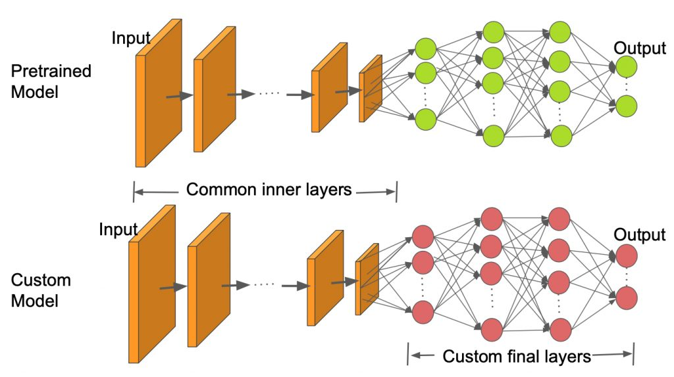
Transfer Learning Architecture

Slide 9
CNN Model
Multilayer neural network ,that specializes in processing data that has grid like topology ,such as image .
It has mainly three layers :- Convolutional layer , pooling layer and fully connected layer .
Image preprocessing is less in CNN model

Slide 10
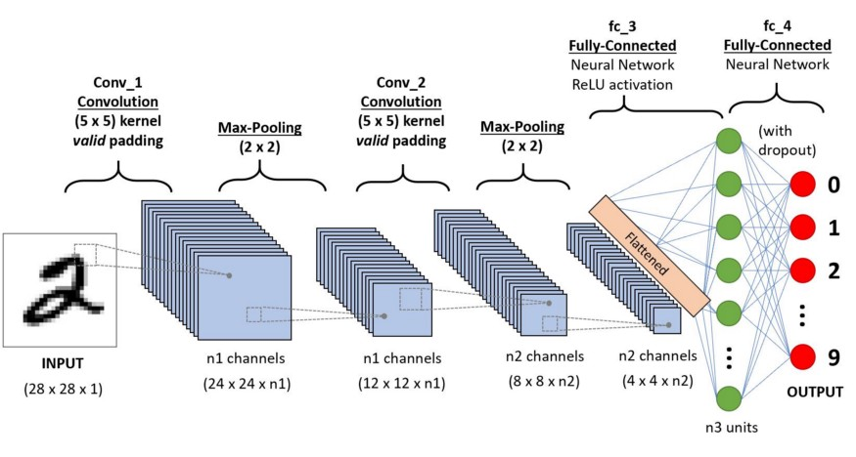
CNN Architecture

Slide 11
VGG-16
VGG 16 was proposed by Karen Simonyan and Andrew Zisserman of the Visual Geometry Group Lab of Oxford University in 2014
It is a kind of CNN model with 16 layers

Slide 12
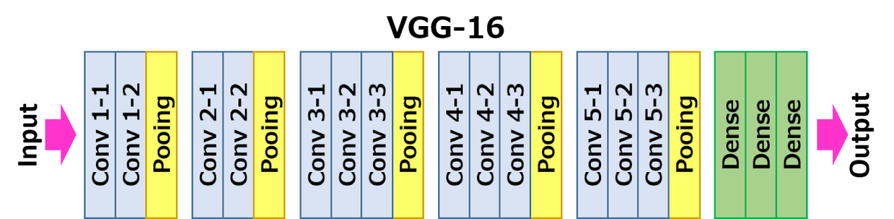
VGG-16 Architecture

Slide 13
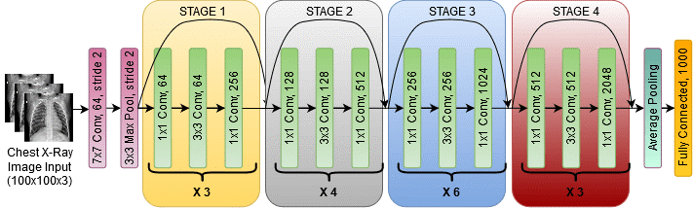
VGG-16 Architecture Map for Covid-19 Detection

Slide 14
ResNet-50
Used to Solve the Problem of Vanishing Gradient.
Use the Concept of Skip Connection.

Slide 15
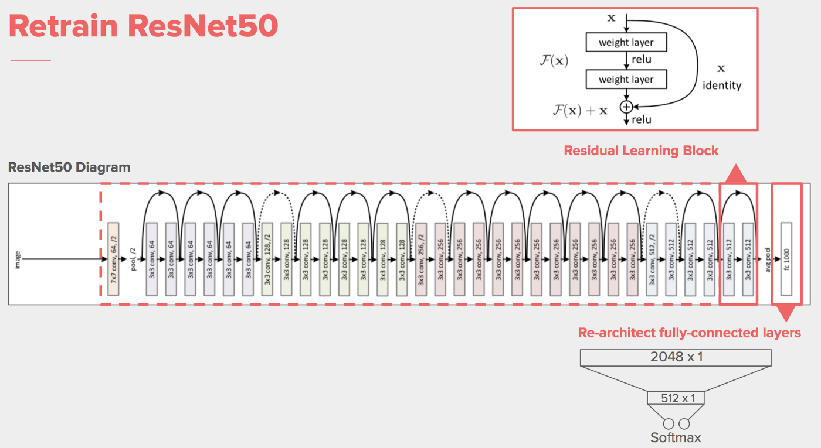
ResNet-50 Architecture

Slide 16
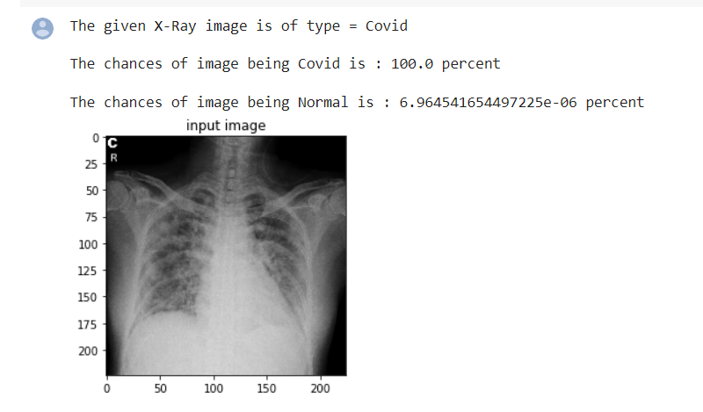
Result(For ResNet-50)

Slide 17
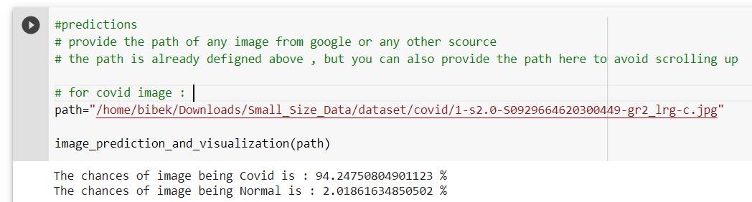
Result(For VGG-16)

Slide 18
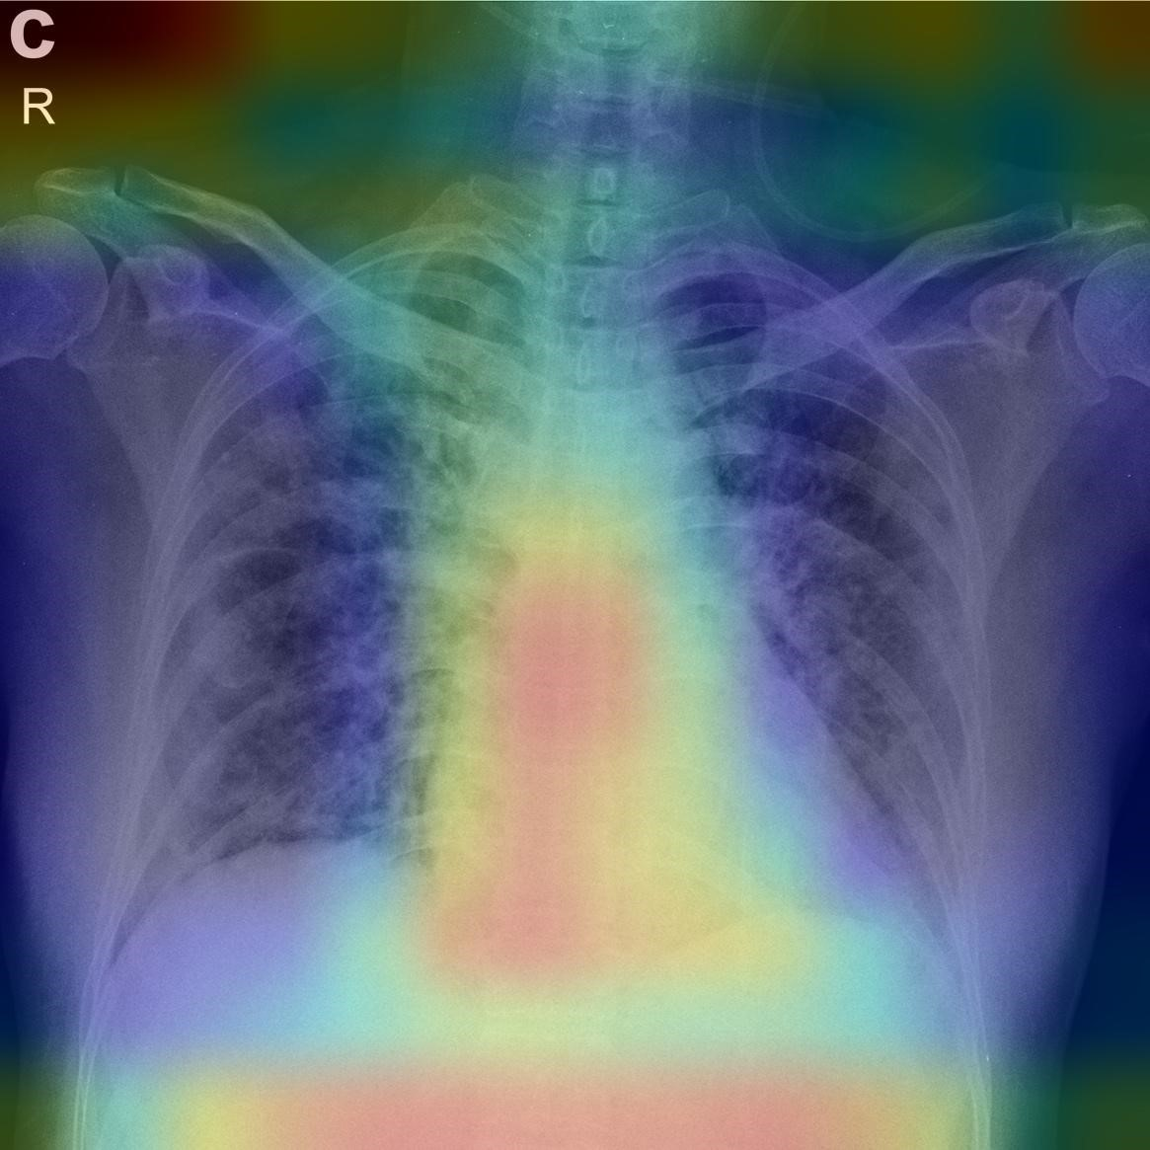
ResNet-50 Result (Covid-19 spot)

Slide 19
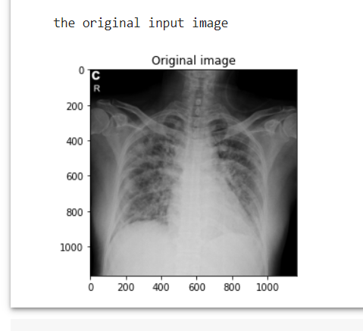
ResNet-50 (Original Image)

Slide 20
Comparison between Proposed Models
Model | Val. Acc | Train. Acc | Val. Loss | Train. loss | Model Size
VGG-16 | 97.92% | 98.75% | 4.53% | 3.28% | 59.5 MB
ResNet-50 | 99.54% | 99.69% | 12% | 3.70% | 97.3 MB
CNN | 97.23% | 95.37% | 10.9% | 12.61% | 483.9 MB
CNN(Global Minima) | 50% | 75% | 72.44% | 54.25% | _________

Slide 21
Innovation
Easy to use
Open source
Best Accuracy
Cost Effective

Slide 22
Model Limitation
Mobile Application
Application GUI Can be Improved
Model Size is Heavy
Feature is limited

Slide 23
Conclusion
VGG-16 Models performs exceptionally .
Actual cost is reduced from 8$ to 2$.

Slide 24


